Slide 1


Titolo presentazione sottotitolo
Projects – Applied Statistics a.y. 2022/23
Team #2 – Analysis of the PISA dataset.
Milano, XX mese 20XX

Slide 3

Firma convenzione Politecnico di Milano e Veneranda Fabbrica del Duomo di Milano
Inserimento secondo logo
Fare clic per modificare lo stile del titolo
Fare clic per modificare lo stile del sottotitolo dello schema
Aula Magna – Rettorato
Mercoledì 27 maggio 2015

Slide 4
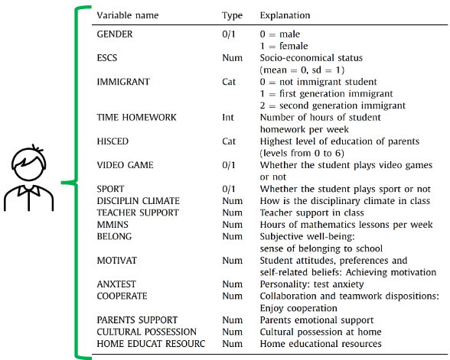
Dataset
The PISA dataset collects data about the academic knowledge and real-life skills of 15 years-old students around the world (https://www.oecd.org/pisa/data/).
The main data files are:
Students-questionnaire.
School-questionnaire.
Teacher-questionnaire.
We will focus on the Students-questionnaire.

Slide 5
Research Question
We want to investigate if there are any relationships in motivation and academic performances in 15 years-old students participating the PISA Study. Furthermore, we would like to understand what drives motivation and if such drivers are the same across different countries

Slide 6
How do we define motivation
We isolated the features (mostly numerical indicators) that we thought would be representative of the motivation:
Index | Description
Expected occupation. | Expected occupational status based on the level of education.
Parents support. | Parent’s emotional support perceived by the students
Competitiveness at school. | How competitive a school is and the students attending it.
Cooperation at school. | Perception of cooperation at school.
Fear of failure. | Perception of fear of failure at school.
Resilience. | How a student is prone to recover quickly from difficulties.
Desire to master knowledge. | Summarizes the student desire to learn and understand the content of classes.

Slide 7
Preliminary analysis
First steps:
Select the features’ columns and rename them.
Eliminate the NA values.
Convert all strings in numerical values.
Visualize data with boxplot.
Since the dataset has too many observations, we focus only on one country (“Italy”).

Slide 8
Preliminary analysis
Analysis done so far:

